Slide 1
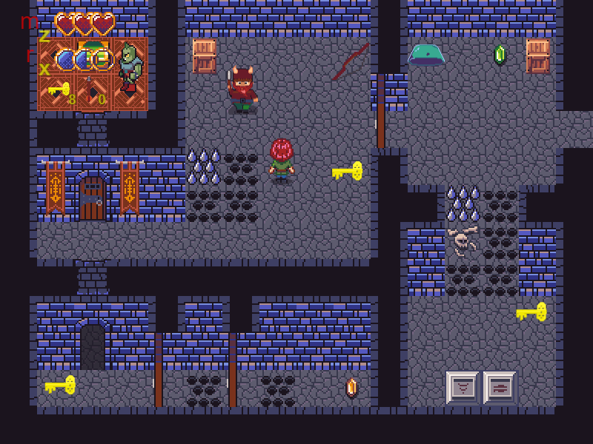
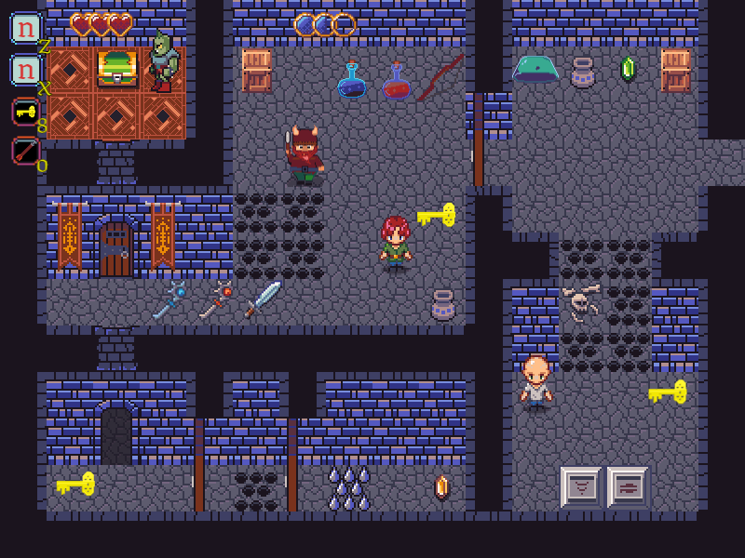
Dagger’s Gate
Pitch Date: 1/31/2021 Today: 3/7/2021 4:00 PM EST
Release Date: 5/23/2021
Team Lead: Vince McKeown 242 Commits total, 62 Week 5

Slide 2

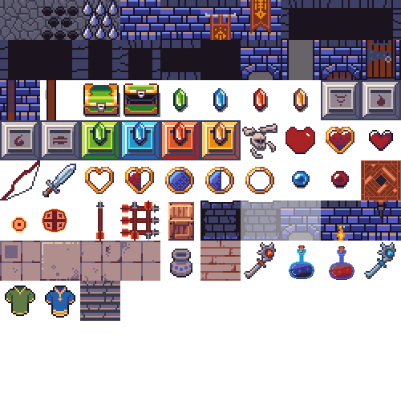
Contributors this week: Kyle Knutson
Updates to WorldGen, Title Screen, buttons

Slide 3
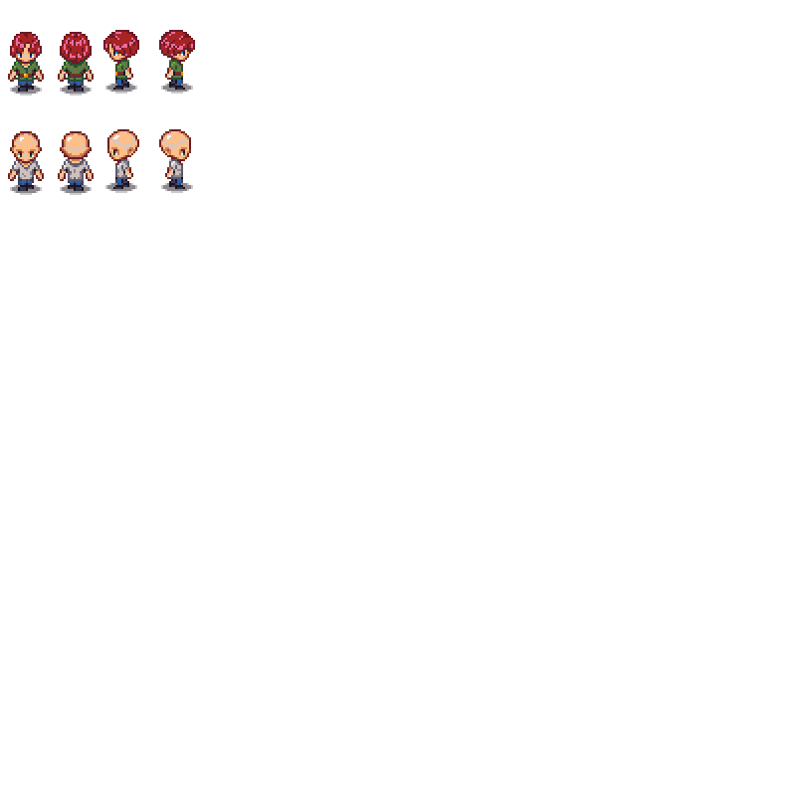
Contributors this week: Tylor Allison
NPC Dialogue / Interactions
Text support wrapping
Breakable objects
Inventory Screen
Colliders
Updates to Melee Attack
Bug fixes
Placeholder art
Updates to UI layout
Additional rooms

Slide 4
Contributors this week: Vince McKeown
Added Sounds for health, mana, and opening doors

